Slide 1
Efficiency of Algorithms
Big-O notation
Montgomery College
Computer Science Department

Slide 2
Big-o Notation
When solving a computer science problem there will usually be more than just one solution.
These solutions will often be in the form of different algorithms.
You will generally want to compare the algorithms to see which one is more efficient.
Big-o Notation is simplified analysis of an algorithm’s efficiency.

Slide 3
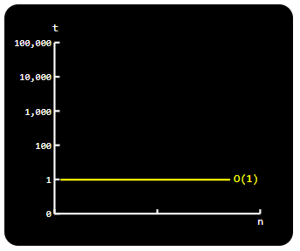
O-notation, family of functions
Constant - O(1)
Describes an algorithm that will always execute in the same time (or space) regardless of the size of the input data set.
/*The time to execute the following
method is always constant regardless
of the size of the numbers array
*/
bool IsFirstElementZero(int[] numbers)
{
return (numbers[0] == 0)
}

Slide 4
Examples of O(1)
The following are examples of operations that take constant time:
  Assigning a value to some variable
    int x =3;
  Inserting an element in an array
    numbers[i] = 10;
  Retrieving element i from an array
  return numbers[i];

Slide 5
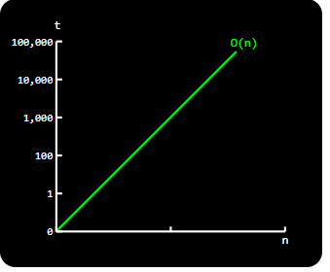
O-notation, family of functions
Linear - O(n)
-Describes an algorithm whose performance will grow linearly and in direct proportion to the size of the input data set.
-The following loop executes n times, if we assume the statement inside the loop is O(1), then the total time for the loop is n*O(1), which equals O(n).
for(int i = 0; i < n; i++)
{
//Do something
//in Constant Time
}
Running time increases linearly
in relation to the number of elements n.

Slide 6
Examples of O(n)
The following are examples of algorithms that take linear time O(n):
Linear Search
Traversing an array
  Finding the minimum, maximum, or how many items match a given value

Slide 7
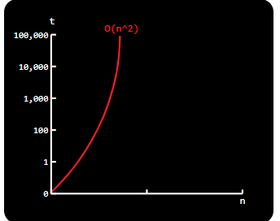
O-notation, family of functions
Polynomial - O(n²)
-Describes an algorithm whose performance is directly proportional to the square of the size of the input data set. This is common with algorithms that involve nested iterations over the data set.
-The first loop executes n times. For each time the outer loop executes, the inner loop executes times. Therefore, the statement in the nested loop executes a total of n* n times. Here the complexity is O(n*n) which equals O(n²).
for (int i = 0; i < n; i++) //Outer Loop
{
for (int j = 0; j < n; j++) //inner loop
{
//Do something in Constant Time
}
}

Slide 8
Examples of O(n²)
The following are examples of algorithms that take quadratic time O(n²):
Performing linear search in a 2-dimensional Array
Selection sort
Insertion sort
Algorithms that scale in quadratic time O(n²) are better to be avoided.
For example once the input size reaches n=100,000 element it can take 10 seconds to complete.
For an input size of n=1’000,000 it can take ~16 min to complete; and for an input size of n=10’000,000 it could take ~1.1 days to complete.

Slide 9
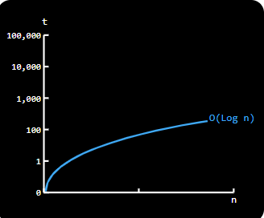
O-notation, family of functions
Logarithmic time: O(Log n)
-Logarithmic time grows slower as n grows. An easy way to check if a loop is log n is to see if the counting variable (in this case: i ) doubles instead of incrementing by 1.
-In the following example int i doesn’t increase by 1 (i++), it doubles with each run thus traversing the loop in log(n) time:
for(int i = 0; i < n; i= i*2)
{
//Do something in Constant Time
}

Slide 10
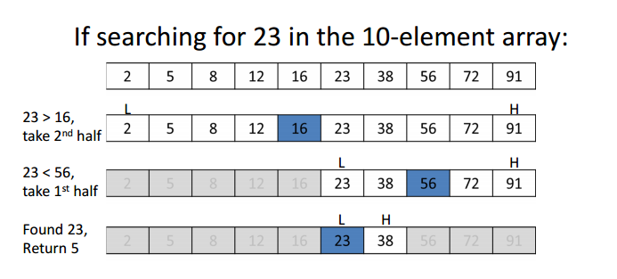
Examples of O(log n)
The following are examples of algorithms that take logarithmic time O(log n) :
Binary Search
Finding largest/smallest number in a binary search tree
The basic premise here is NOT using the complete data, and reducing the problem size with every iteration.
Logarithmic algorithms have excellent performance in large data sets

Slide 11
Worst Case, Best Case and Average Case analysis of algorithms
Best Case Analysis
Calculates lower bound on running time of an algorithm.
Is the case that causes minimum number of operations to be executed.
Example: when searching the array linearly, the best case occurs when the element to be searched is at the first location. The number of operations in the best case is constant (not dependent on n). So time complexity in the best case of linear search would be O(1).

Slide 12
Worst Case, Best Case, Average Case analysis of algorithms
Worst Case
Calculates upper bound on running time of an algorithm.
Is the case that causes maximum number of operations to be executed.
Example: when searching the array linearly, the worst case happens when the element to be searched is not present or is the last element in the array causing nearly n comparisons to find the element.
Therefore, the worst case time complexity of linear search would be O(n).

Slide 13
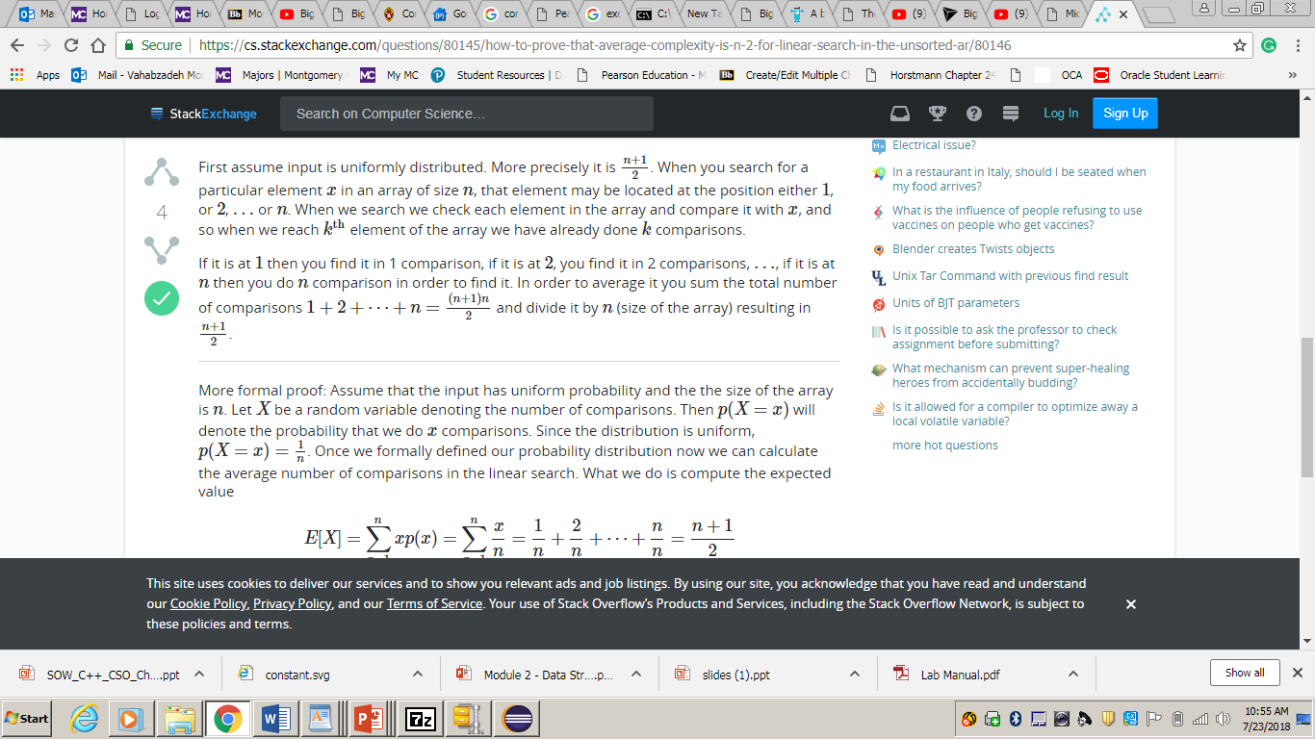
Worst Case, Best Case, Average Case analysis of algorithms
Average Case
Element is somewhere in the middle of the array.
Example: when searching the array linearly, the number of comparisons to find an element in an array of n elements is :
Divide the above equation by n to find the average
Therefore Average is :
Therefore, the average case time complexity of linear search would still be O(n).

Slide 14
Big O Notation and The Space/Time Trade Off
An efficient algorithm takes a reasonable amount of time, but may be using a reasonable amount of computer memory (space) as well.
You may be willing to pay more for extra memory if this allows data to be processed more quickly, while other users may have to settle for a slower processing time in order to economize on memory.

